Slide 1
Exploring the USA’s 2019 National Health Interview Survey
Fouad Yared, 12/3/20

Slide 2

Roadmap
Overview, purpose
Survey design: Target population, Sampling plan
Data collection
Surveys administered
Question Topics: In 2019, Future Years
Sample size, response rates
Survey weights
Calculations

Slide 3
National Health Interview Survey
Annual survey conducted by Census workers since 1957
Purpose: Main source of health information on US population
Focuses on the civilian, noninstitutionalized population
Inquires about the “amount, distribution, and effects of illness and disability in the United States”¹
Department of Health and Human Services uses it to monitor trends
Public health researchers use it to learn about access to health care, evaluate Federal health programs
1: National Center for Health Statistics. Survey Description, National Health Interview Survey, 2019. Hyattsville, Maryland. 2020.

Slide 4

Survey design: Target population
Included in Universe
Excluded from Universe
Household residents
Persons in “Noninstitutional group quarters”
homeless shelters, rooming houses, and group homes
Persons with no fixed household address
Active-duty military personnel and civilians on military bases
Persons in long-term care institutions
Nursing homes, hospitals for ill/disabled
Persons in correctional facilities
Jails, prisons, juvenile detention, halfway houses
US nationals living in foreign countries

Slide 5
Survey design: Sampling
Sampling plan, Sampling process
Final sample
Redesigned after every decennial census. 2010 Census used for 2016-2025 NHIS
Split the US into 1,689 geographic areas
Counties, county equivalents, or groups of counties. Usually contiguous, always within states.
Divide areas in two strata based on density (urban vs rural)
Areas in some states only have one stratum
Clusters of addresses are found within each stratum
1st PSU: Each cluster systematically selected from each stratum
Clusters within geo areas; ~2,500 addresses per cluster
Number of clusters chosen is proportional to the size of the strata
Exception: more clusters chosen in 10 least populous states, D.C. to get minimum number of addresses
2nd PSU: Addresses sampled within clusters (details not mentioned)
Commercial address lists used, some areas did not include all eligible household addresses
534 clusters of addresses
Found in 310 geographic areas
Clusters determined which geographic areas were included (unlike previous iterations of survey)
There was at least one cluster selected in each state
Reason for using clusters within strata:
Large simple random sample of households
“would be prohibitive”
“too dispersed throughout the nation for cost-effective interviewing”
Each month’s clustering sample said to be “nationally representative”
Sampling probability: # of clusters proportional to size of strata to better estimate the variance in larger strata
Difficulties: Figuring out how to sample addresses with an equal representation

Slide 6
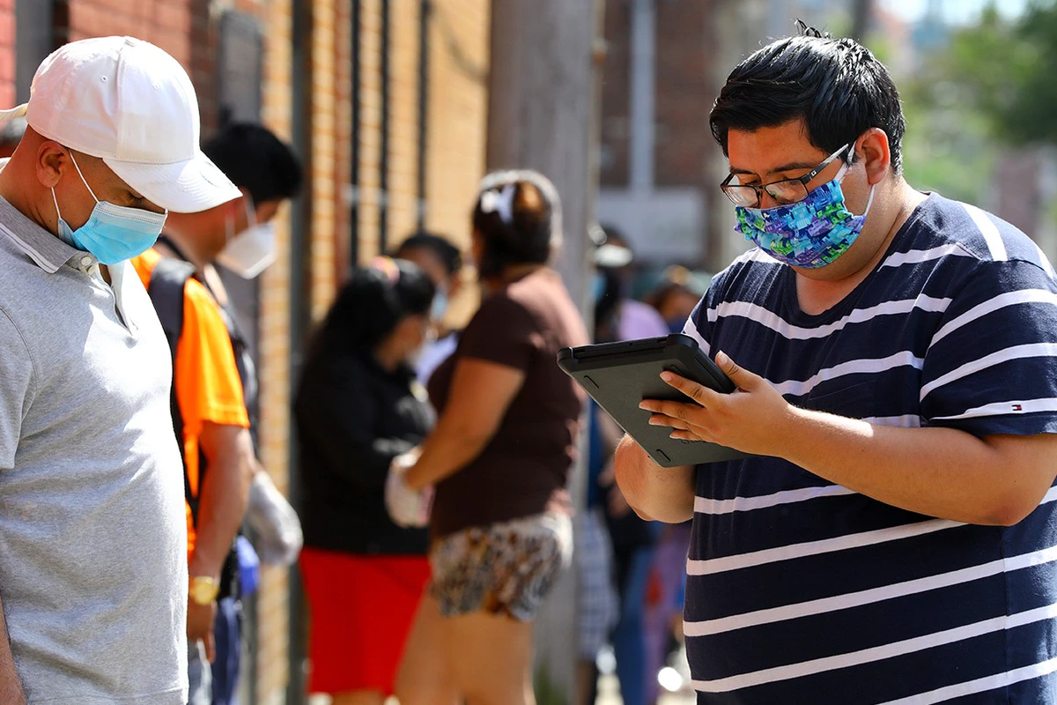
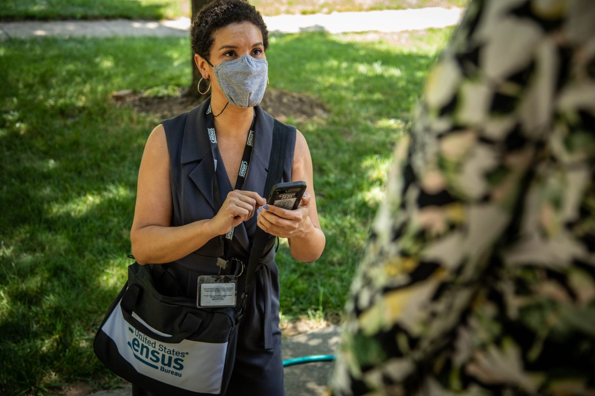
Data collection
Interviewers from Census Bureau
Voluntary Participation
Questions on computer
Questions based on prior answers
Initial interview
Face-to-face
By phone if respondent requests, weather is bad, travel distance too far
Follow-up
Conducted by phone
34.3% of Sample Adult interviews in 2019 were conducted partially by phone (unclear if initial or follow-up)

Slide 7
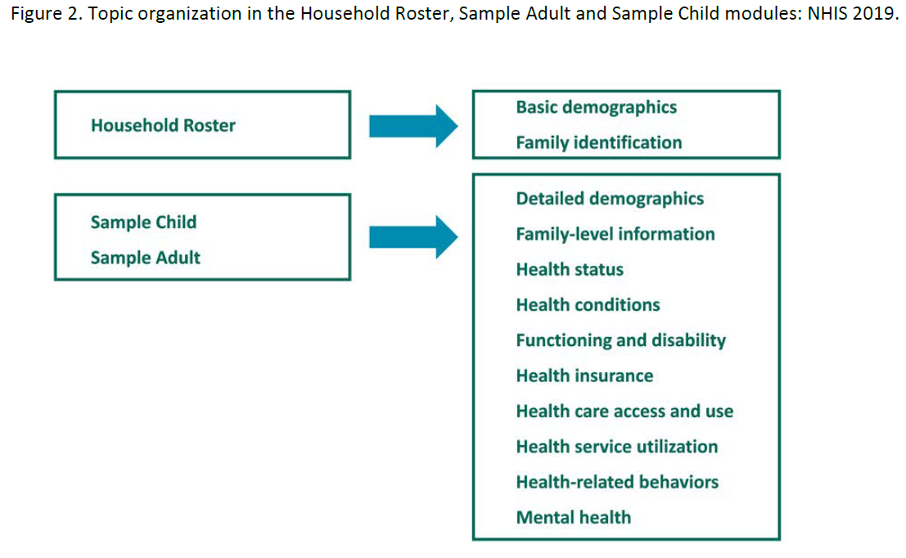
Surveys administered
Household roster
Who lives in the household and basic demographics
One “sample adult” randomly chosen (age 18+)
One “sample child” randomly chosen (age 17 or younger)
Sample Adult / Sample Child
Interview Qs vary somewhat based on age, sex
Sample Adult information
Comes from adult unless physically or mentally unable to do so
Sample Child information
Comes from parent or adult responsible for health care of child. Could be sample adult
Either interview may appear first
Sample Adult can be done if no children in home
2019 redesign
Removed Family Interview:
Detailed relationships of family members, information on each family member on various topics like health insurance, employment and earnings
Difficulties: How/why to change the survey in 2019 redesign

Slide 8
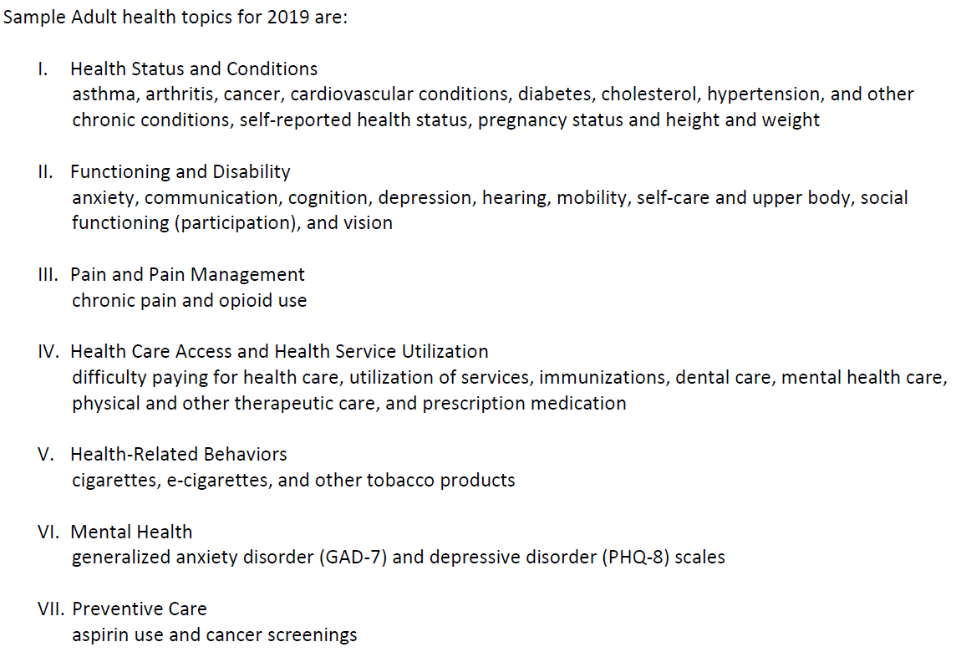
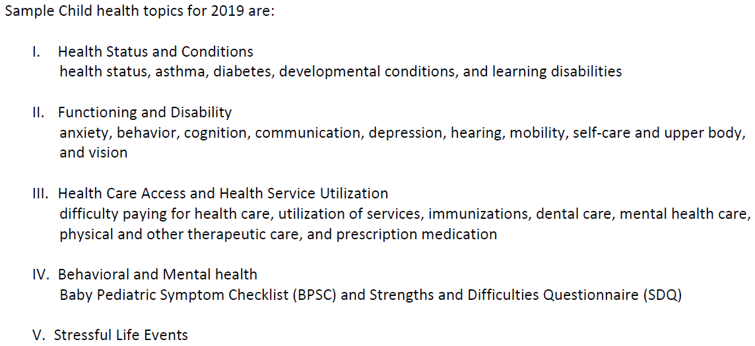
2019 Question Topics
Topics of Sample Adult Qs
Topics of Sample Child Qs

Slide 9
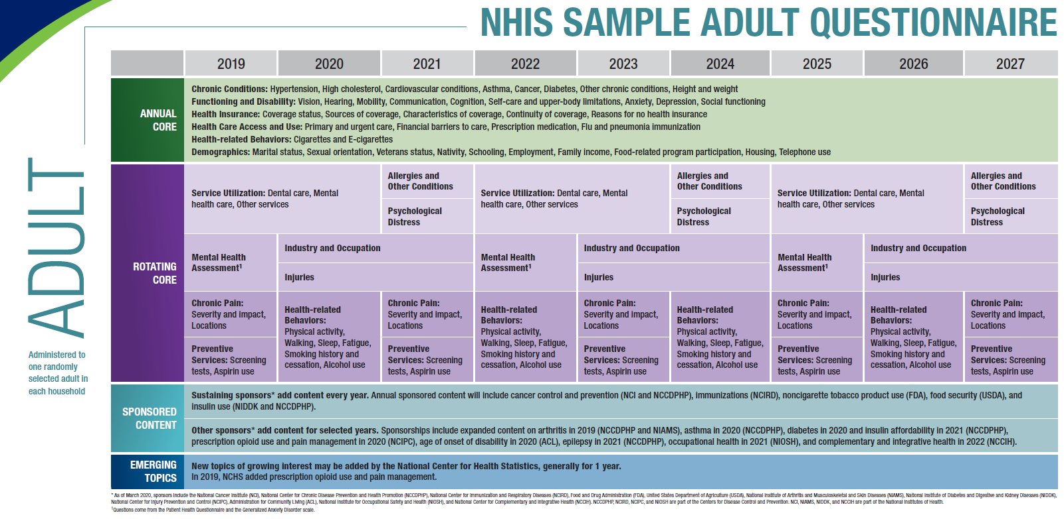
Future Question Topics

Slide 10
Sample size, response rates
Sample size
Response Rates
35,404 Households
Completed a household roster
33,138 Households
Completed household roster and substantial portion of family interview
31,997 Sample Adult surveys
35,365 eligible sample adults from HH with completed roster
9,193 Sample Children surveys
10,155 eligible sample children from HH with completed roster
Household roster completion 65.3%
35,404/54,231 = 65.3%
Household Response Rate 61.1%
31,138/54,231 = 61.1%
Final Sample Adult Response Rate 59.1%
31,997/35,365 * 65.3% completed household rosters
Final Sample Child Response Rate 59.1%
9,193/10,155 * 65.3% completed household rosters
It’s unclear if there were any methods used to reduce nonresponse, aside from sending an Advance Letter.
NHIS Documentation did not mention specifics
Incentives were not mentioned either

Slide 11
Survey weights
Weights
Sample Adult, Sample Child weights
Base weight
inverse of probability of being in the sample (inclusion probability)
Adjusted for non-response
Different response rates among different household and person-level subgroups
Change in approach
1997-2018: based on geography
Post-stratification: sum of weights equaled age, sex, race/eth and overall totals
2019: multilevel logistic regression
Outcome: Households split into quintiles based on response propensities. Predictors: related to response rates, health outcomes
Weight: 1/(median response propensity for quintile). Capped at 2.5
Covariates, cap to be reviewed annually
Raking used instead of post-stratification for sum of weights. Able to handle more variables.
Added: EDU attainment, census division, MSA
Multiplied by Adult or Child inclusion probability in HH
WTIA_A, WTIA_C
Interim: Annual, Before Post-Stratification (Raking) Calibration
WTFA_A, WTFA_C
Final: Annual, After Calibration
(public use data file includes pseudo strata and pseudo PSUs)
<- The multilevel logistic regression (not covered in class) and the raking methodology were noteworthy design and calculation features.

Slide 12
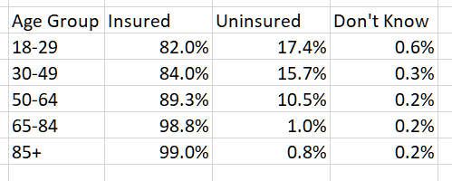
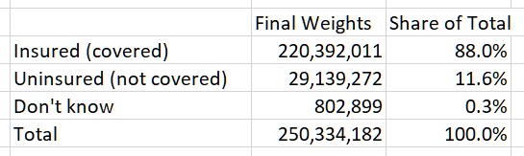
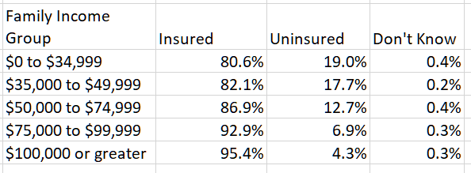
Calculating: Insurance Coverage Rates
Weighted
By Age, Income Group
Overall, national figures:
95% CIs:
Insured 87.4-89%
Uninsured 11-12%
Don’t know 0.2-Undetermined %
Unweighted frequencies are
Insured 90.68%
Uninsured 9.02%
Don’t know 0.30%
Note: Percentages used along with final weights
for ease of interpretability

Slide 13
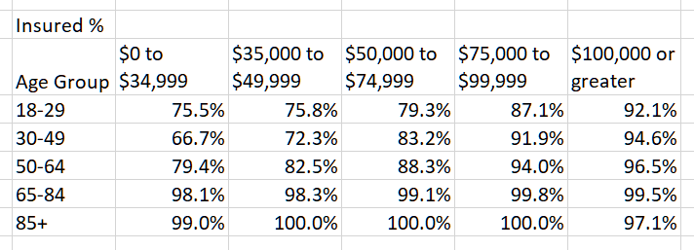
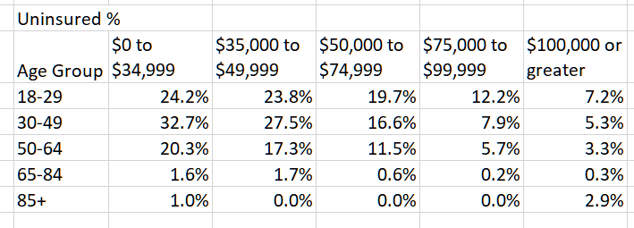
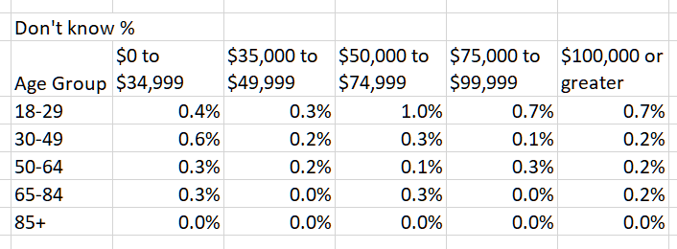
Coverage rates by Age and Income Groups
*Medicaid income cap varies by state and household size. Likely worth further disaggregating lowest income groups.
Many youth may be on parent’s insurance plan until age 26.
Other categorical variables: sex, race (with and without Hispanic ethnicity), educational attainment

Slide 14
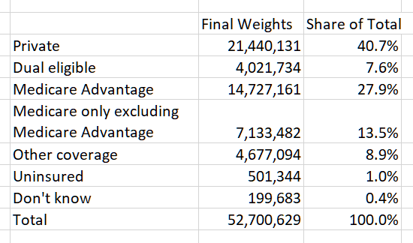
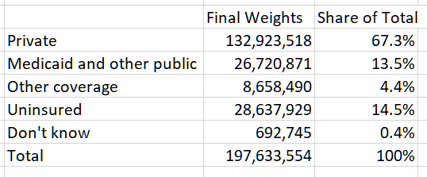
Types of Coverage
For Adults 18-64
For Adults 65 or older

Slide 15
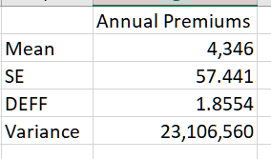
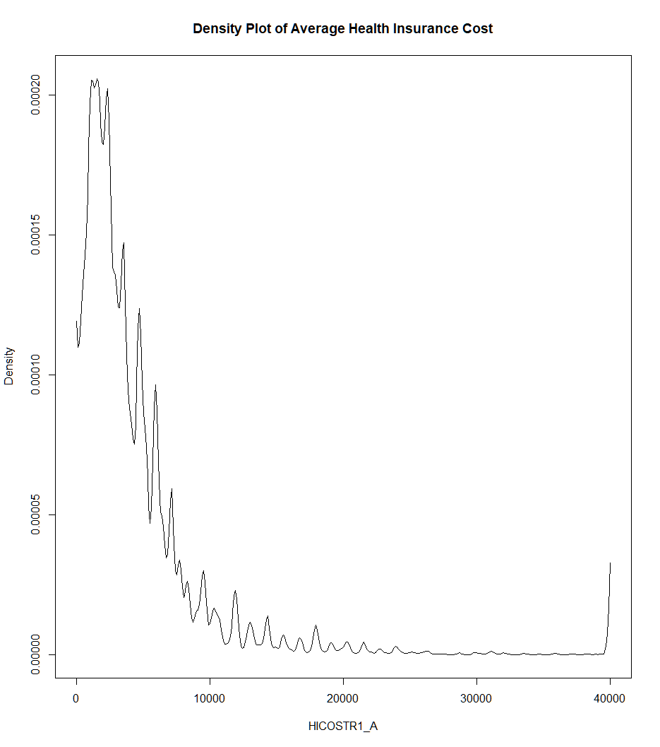
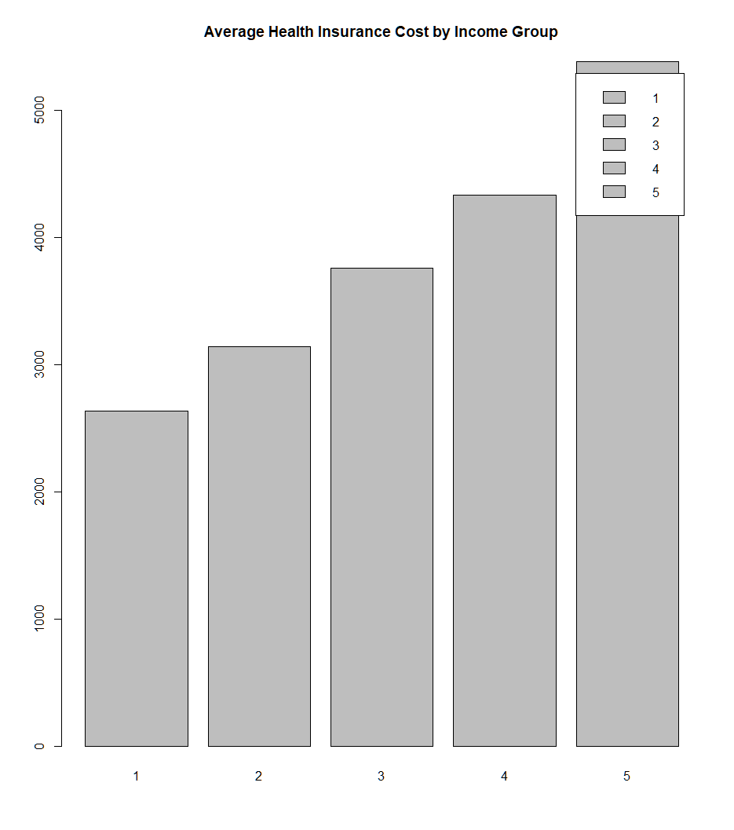
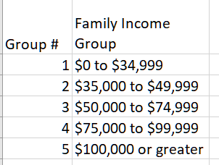
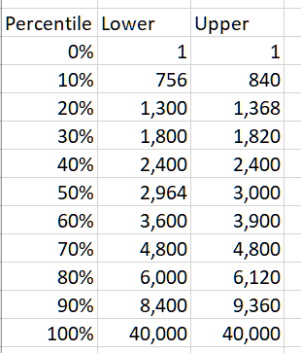
Cost of Annual Premiums (Private Insurance)
Note: This does not include Adults without Coverage.
Worth looking into very high Annual Premiums.

Slide 16
Note: This does not include Adults without Coverage.
Worth looking into very high Annual Premiums.

Slide 17
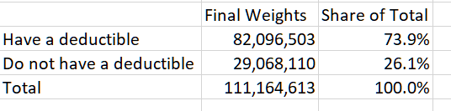
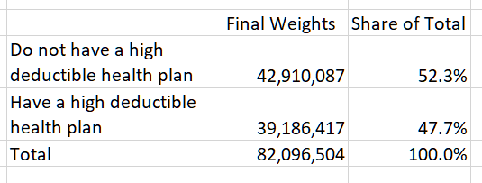
Deductibles of Private Health Care Plans
Top table: Universe includes those with Private Plan
Bottom table: Universe includes only those with a deductible
High deductible varies based on the number of people in household. Deductible threshold for one person is $1,350 and for two or more people it’s $2,700.
Differences due to rounding.

Slide 18
References
National Center for Health Statistics. National Health Interview Survey, 2019. Public-use data file and documentation. https://www.cdc.gov/nchs/nhis/data-questionnaires-documentation.htm. 2020.
Link to public data, documentation: https://www.cdc.gov/nchs/nhis/2019nhis.htm

